Slide 1


Kolozsvári konferencia
2017. Április 26-29.

Slide 2
Résztvevők
  Tóth Blanka
  Teski Tamara
  Müller Anna
  Fülöp Anna
  Molnár Dániel

Slide 3
Program
Tuesday, 17th of April
Arrival of the participants
20:00 – “Bonding” night

Slide 4
Program
Wednesday, 18th of April
09:00 – Registration Desk
09:45 – Official Opening
10:15 – Scientific Session: Chemistry
11:00 – 11:30 – Coffee Break
12:30 – 14:30 – Lunch
14:30 – Plenary Session: Prof. Dr. M. Concepción Gimeno – (University of Zaragoza, Spain) - Synthesis and Applications of Functionalised N-Heterocyclic Carbene Gold Complexes
15:15 – Scientific Session: Chemistry
16:15 – 16:30 – Coffee Break
16:30 – Scientific Session: Chemistry
  17:00 - Cinchona alkaloid catalyzed Michael reaction of indole derivates - Blanka Tóth
  17:15 - Synthesis and development of red fluorescent calcium sensors for two photon imaging – Anna Fülöp
19:00 – Opening Dinner Party (Black tie dress code)

Slide 5
Thursday, 19th of April
09:00 – Plenary Session: Prof. Dr. Camelia Bala (University of Bucharest, Romania) - Tunable Scaffolds as Supports for Biosensing Applications
09:45 – 10:00 – Coffee Break
10:00 – Scientific Session: Posters
  P01 - The effects of genotoxic stress factors on DNA repair mechanisms in Mycobacteria – Dániel Molnár
  P02 - Optimization of specific amino acid labelling on single protein and extension to transmembrane proteins in plasmamembrane of eukaryotic cells – Anna Müller
  P03 - Stabilizition and isomerization of phosphorus ylides – Tamara Teski
12:30 – 14:30 – Lunch
14:30 – Plenary Session: Assoc. Prof. Andrea Salis (Faculty of Science, University of Cagliari, Italy) - Salty water: easy to do but difficult to understand. The Hofmeister series
15:15 – Scientific Session: Posters
18:00 – Dinner
20:00 – Board Games Night Out

Slide 6
Friday, 20th of April
09:00 - Plenary Session: Dr. Paul Vasos (University of Bucharest, Romania) - Symmetry goes a long time:hyperpolarised magnetic resonance and long-lived spin states
09:45 - Plenary Session: Prof. Edison Muzenda (Botswana International University of Science and Technology) - Waste - a Valuable Resource for sustainable cities: lessons learnt form City of Linkoping, Sweden for City of Johannesburg, South Africa Biogas project
10:30 – 11:00 – Coffee Break
11:00 – Scientific Session: Chemical Engineering
12:30 – 14:30 – Lunch
14:30 – Scientific Session: Chemical Engineering
15:30 – Research Laboratories Visits
18:00 – Dinner

Slide 7
Saturday, 21st of April
09:00 – Scientific Session: Chemistry
12:30 – 14:30 –Lunch
16:00– Closing Ceremony
Sunday, 21 th April
11:00 – 16:00 – Trip: Turda Salt Mine

Slide 8
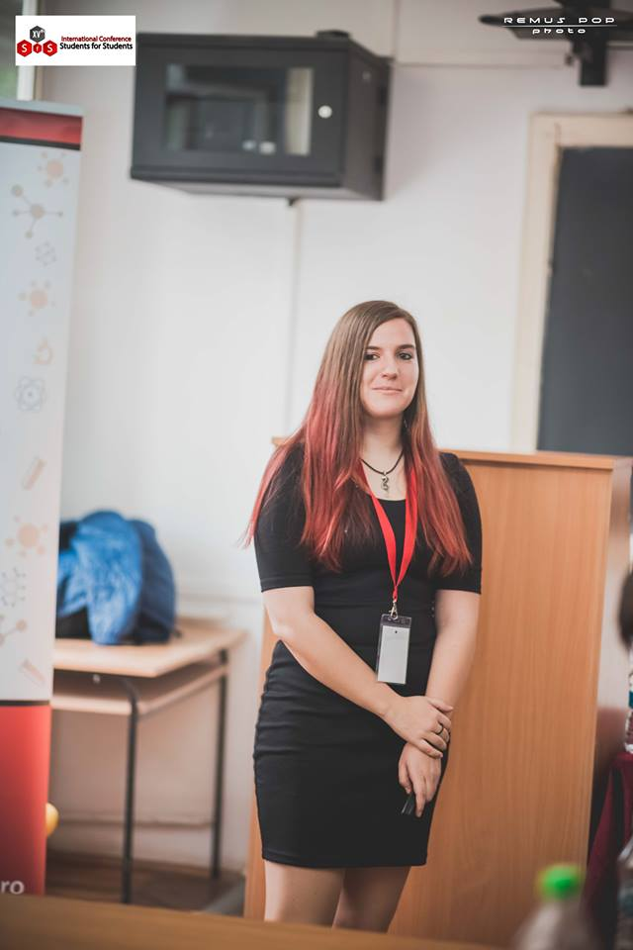
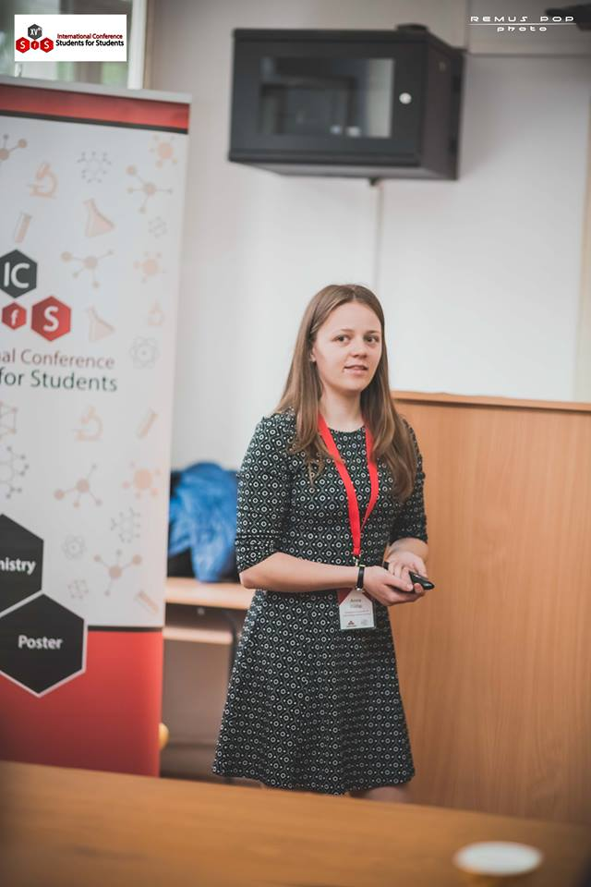
Előadások

Slide 9
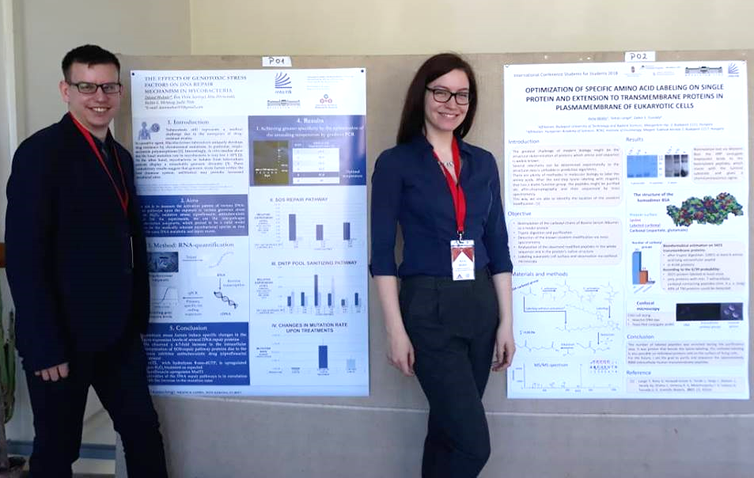
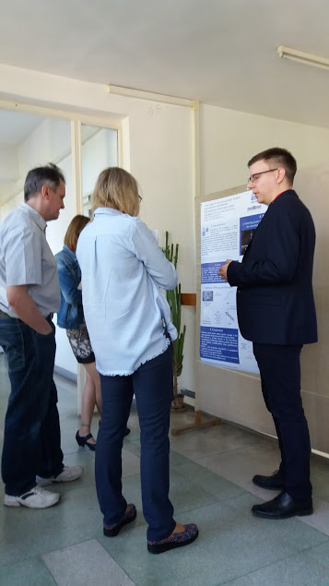
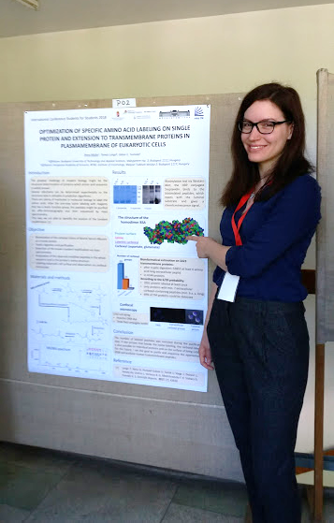
Poszterek

Slide 10
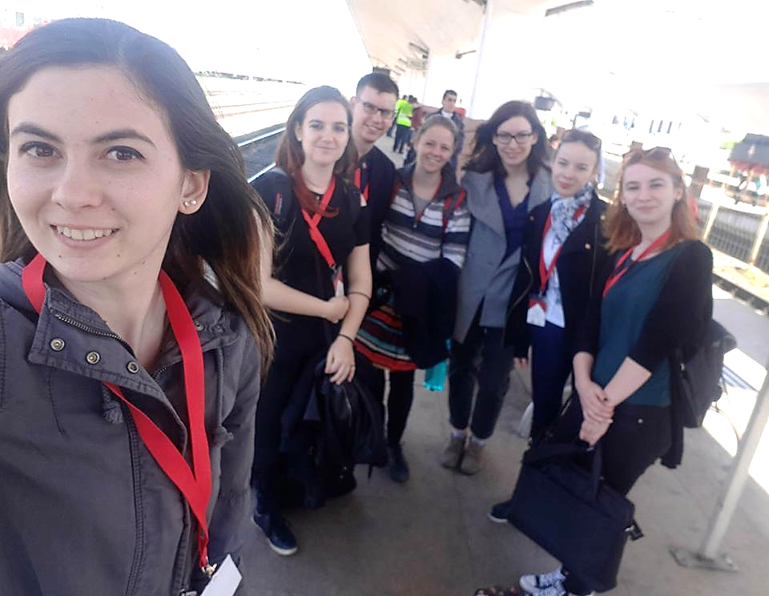
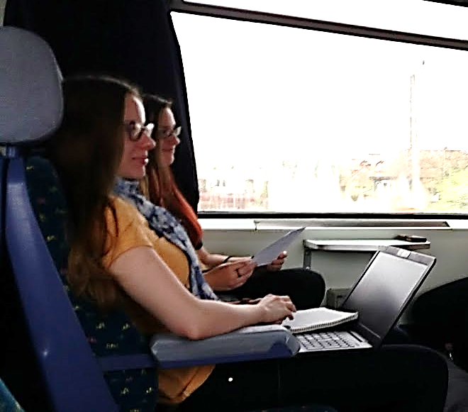
Utazás

Slide 11
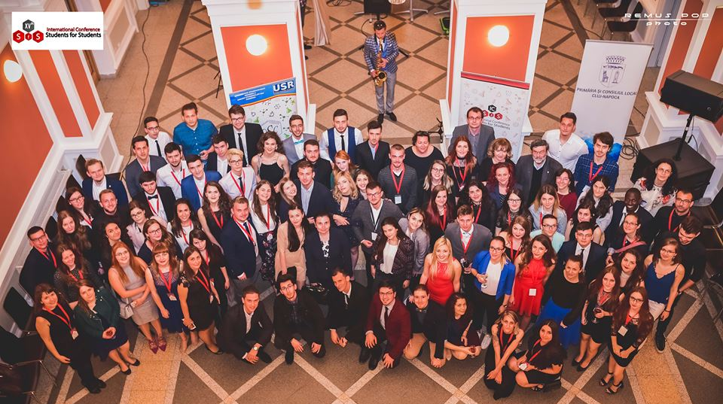

Slide 12
Köszönjük a részvételi lehetőséget!

